Slide 1
ML Discussion on Polymer membranes for flow batteries
Design and preparation of sulfonated polymer membranes for Zn/MnO2
flow batteries with assistance of machine learning
Journal of Membrane Science, 2023 Feb
Wei Wei , Songbo Nan , Haoran Wang , Shicheng Xu , Xiaoxiao Liu , Ronghuan He
Presented by Chamod Hasaranga Peiris - 6678202263

Slide 2
Introduction to the Problem
Aqueous zinc-ion batteries (AZBs) have been regarded as the promising technique for large-scale energy storage.
Polymer electrolyte in AZBs;
Effectively transporting zinc ions
Separating anode and cathode zones and suppressing the growth of Zn dendrites.
AZBs - problems from low Zn²⁺ conductivity of polymer electrolytes and uncontrolled Zn dendrite formation caused by non-uniform Zn²⁺ ion flux in Zn anodes. (which results in the sharply capacity decay and insufficient energy density of the relevant AZBs)

Slide 3
Research Project Highlights
Predict effects of functional groups of the polymer on its cation conduction by machine learning.
Increased peak power density: Indicates faster charging and discharging.
Enhanced specific capacity: Represents more energy stored per unit area.
Stable cycling performance: Shows consistent efficiency over prolonged use.
Fabricate polymer membranes rich in amino groups based on predicted results of machine learning.
The proposed membrane exhibits superior conductivity to zinc ions at room temperature. (Properties Comparison)
The use of the membrane electrolyte has been demonstrated in the Zn/MnO2 flow battery

Slide 4
Key Points
Machine learning model to predict the contribution of polymer functional groups to ionic conductivity of both Zn²⁺ ions and protons by using the gradient boosting decision tree (GBDT) algorithm
A series of crosslinked polymers synthesized and sulfonated to fabricate the sulfonic acid group containing membranes.
The prepared membrane reaches a Zn²⁺ conductivity of 12 mScm⁻¹, and a proton (H⁺) conductivity of 22 mScm⁻¹ in water.
Using the proposed membrane as the electrolyte, the Zn/MnO2 flow battery working at room temperature delivers a peak power density of 150 mWcm⁻², a specific capacity of 1.95 mAhcm⁻², and a cycling capacity retention rate of 71% after 1000 cycles at 30 mAcm⁻².

Slide 5
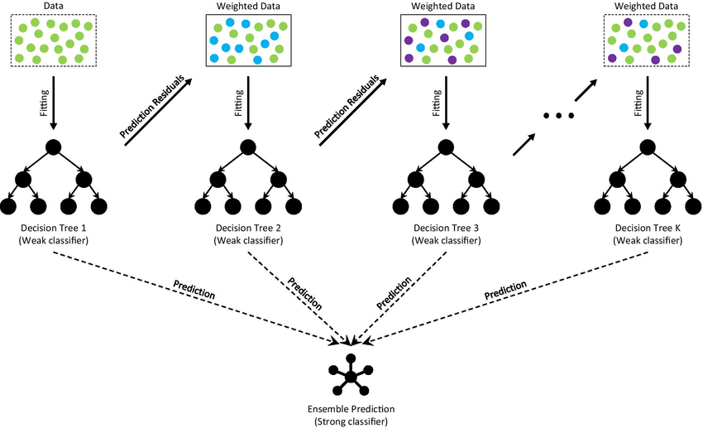
Gradient Boosting Decision Trees
Trees are built sequentially, and each tree corrects the errors of the previous one.
Adjusts the weights of data points during training, giving more importance to instances that were misclassified by previous trees.
More sensitive to outliers
Algorithm uses gradient descent to minimize the overall loss function

Slide 6
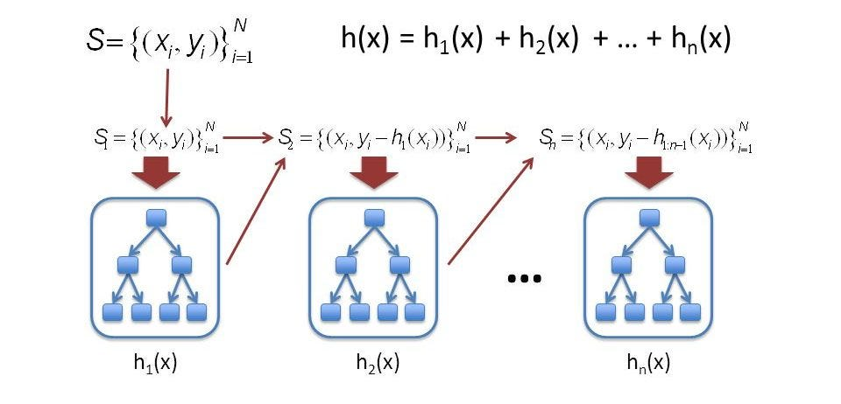
GBDT Regression Only Explanation

Slide 7
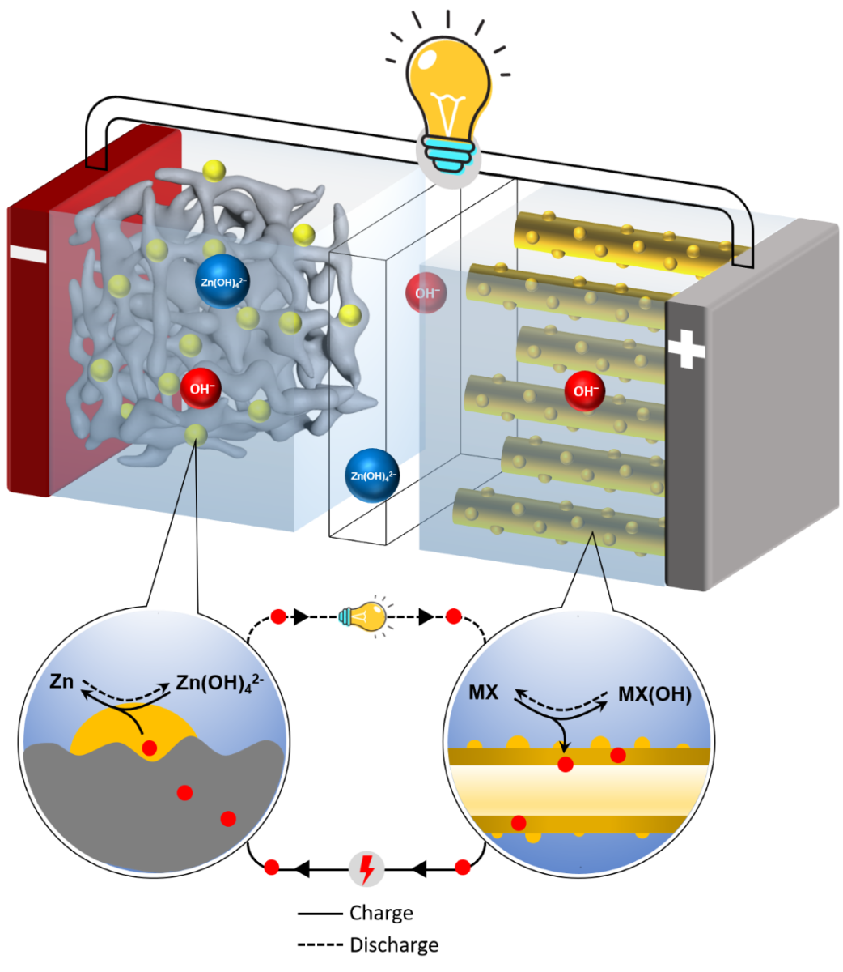
Membrane Design and Performance Enhancement sulfonated polymer membranes play a crucial role in Zn/MnO2 flow batteries
Separate the electrolyte into anode and cathode compartments: Preventing direct contact between Zn and MnO₂, which prevents unwanted side reactions.
Allow selective ion transport: Facilitate efficient passage of Zn²⁺ ions while significantly blocking H+ ions.
The designed membranes in the study showcased enhanced performance through:
High Zn²⁺ conductivity: This enables efficient charging and discharging by facilitating rapid movement of charge carriers.
Low H⁺ conductivity: This minimizes H⁺ crossover across the membrane, reducing energy loss and dendrite formation.
Improved mechanical stability: Ensures long-term durability and leak-proof operation of the battery.

Slide 8
Data collection for construction of models in machine learning
The raw experimental data were collected from original papers
85 pieces of published papers involving in zinc ion conducting polymer electrolytes and proton exchange membranes grafted with typical functional groups.
The dataset was setup by recording;
functional groups, water uptake, Zn²⁺ and H⁺ conductivities of every polymer electrolyte corresponding to different IEC and conductivity measurement temperature.
Train Set 0.9 & Test Set 0.1
90% of the dataset was used to construct the decision tree as training data; while the rest of others was used as the test data to evaluate the prediction accuracy.

Slide 9
Total dataset containing Features
Monomer Types
Sulfonation degree
Crosslinking agents
water uptake
IEC values (Ion Exchange Capacity)
conductivities and measured temperature
functional groups of the polymer membranes
According to the types of functional groups, the total dataset could be divided into eleven subsets.
Functional groups of amino (including secondary amine and tertiary amine), imidazole, amide, ether, carboxyl, ester, carbonyl, hydroxyl, triazole, cyano and sulfonic acid for Zn²⁺ and/or H⁺ conduction.

Slide 10
Used Algorithms to Compare
Logistic Regression (LR)
Support Vector Machine (SVM)
K-Nearest Neighbor algorithm (KNN)
Gaussian Processes (GPC)
Gradient boosting decision tree (GBDT)

Slide 11
Construction of the Machine Learning Model
Data Preparation:
Input Data: Chemical features of the polymer, including monomer types, sulfonation degree, crosslinking agents, and other relevant structural parameters.
Output Data: Zn²⁺ and H⁺ conductivities of the corresponding polymer membranes.
Model Training:
Algorithm: GBDT was chosen due to its ability to handle complex relationships between features and its robustness to noise in the data.
Training Dataset: The dataset likely consisted of existing sulfonated polymer membranes with known properties (Zn²⁺ and H⁺ conductivities)

Slide 12
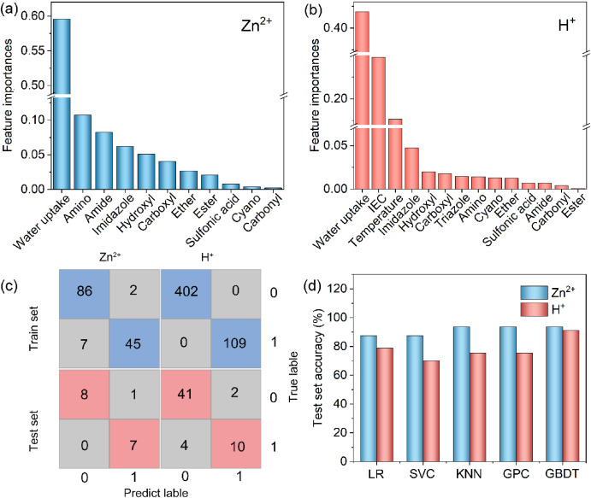
Model Training (Continues):
Training Process: The GBDT model was trained iteratively. In each iteration, a decision tree is built based on the current residuals of the model. This tree predicts the difference between the actual and predicted conductivity for each data point. The predictions are then added to the existing predictions, and the process repeats until the model converges or a predefined stopping criterion is met.
Model Validation:
Validation Dataset: A separate set of polymer membranes with known properties was used to assess the model's performance on unseen data.
Metrics: Mean squared error (MSE) and R-squared were used to evaluate the accuracy of the model's predictions for both Zn²⁺ and H⁺ conductivities.
Confusion matrix has stated in the main article to justify the model validation

Slide 13
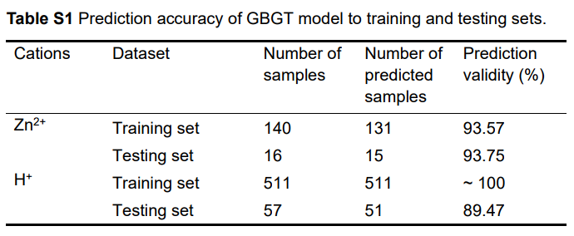
Correlation Matrix Values

Slide 14
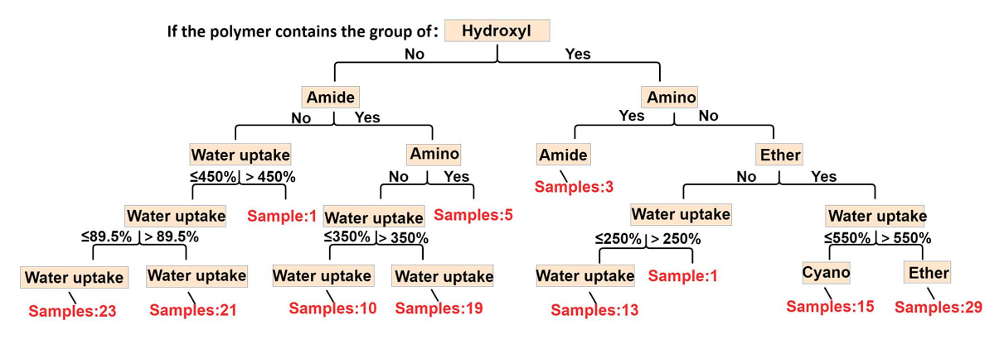
The visual structure of the 100th decision tree to the polymer electrolytes for Zn²⁺ and H⁺ conduction

Slide 15
Feature Importance:
GBDT has an ensemble approach to find aggregating feature importance across multiple decision trees.
According to the comprehensive results of 100 decision trees, they have obtained the feature importance to ionic conductivity of polymer membranes by machine learning.
Consecutively, researchers evaluate the correlation between each feature and the target variable. Features with higher absolute correlation values are considered more important.

Slide 16
Algorithm Comparison:
The authors have compared the GBDT model with other classification models built, such as K-Nearest Neighbor (KNN), Logistic Regression (LR), Support Vector Machine (SVM), and Gaussian Processes (GPC) to justify their choice. The comparison likely focused on:
Prediction accuracy: Comparing the chosen metrics (MSE, R-squared) on the validation dataset.
Model interpretability: GBDT models offer some degree of interpretability compared to SVMs, which could be important for understanding the relationships between polymer features and conductivity.
Computational efficiency: Training and testing time, especially for large datasets, might be considered.

Slide 17
Justify the Most Efficient Algorithm
GBDT has the highest accuracy to both training set and test set, which is suitable for solving existing problems. (R² – Score Compared)

Slide 18
Hyperparameter Tuning:
The model's performance is highly dependent on its hyperparameters (learning rate, n_estimators or number of trees in GBDT, min_samples_leaf).
Optimum Hyperparameter values for Zn²⁺ and proton conductivity for each model in comparison have stated in one of the supplementary article regards to this research.
The authors likely used techniques like grid search or random search to find the optimal combination of hyperparameters that maximized the model's accuracy on the validation dataset. (Since more than 5 algorithms have been tested under different hyperparameter combinations)

Slide 19
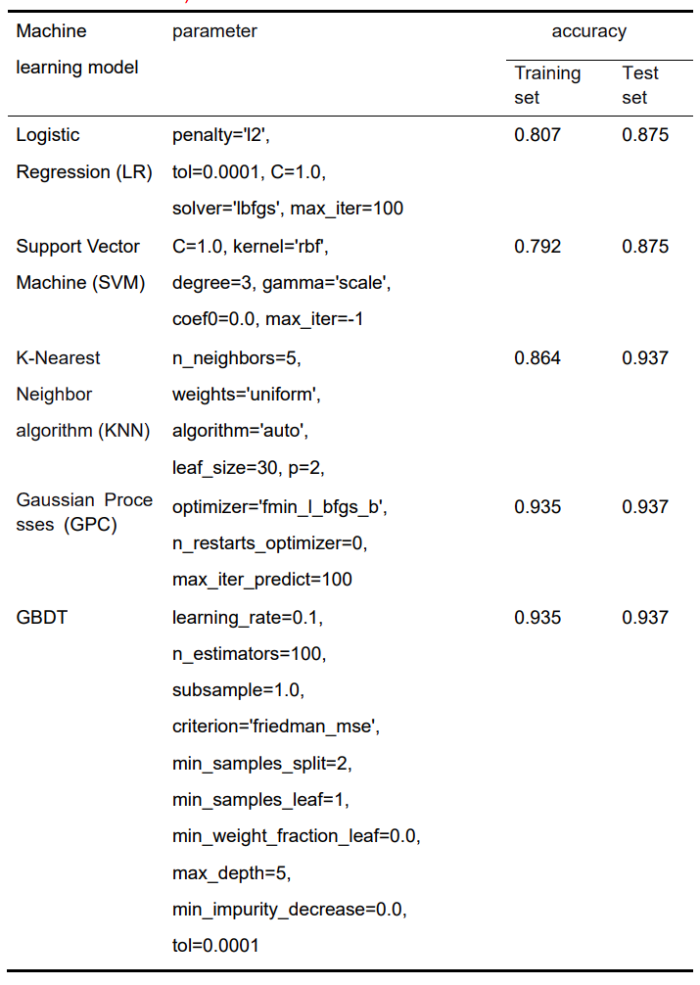
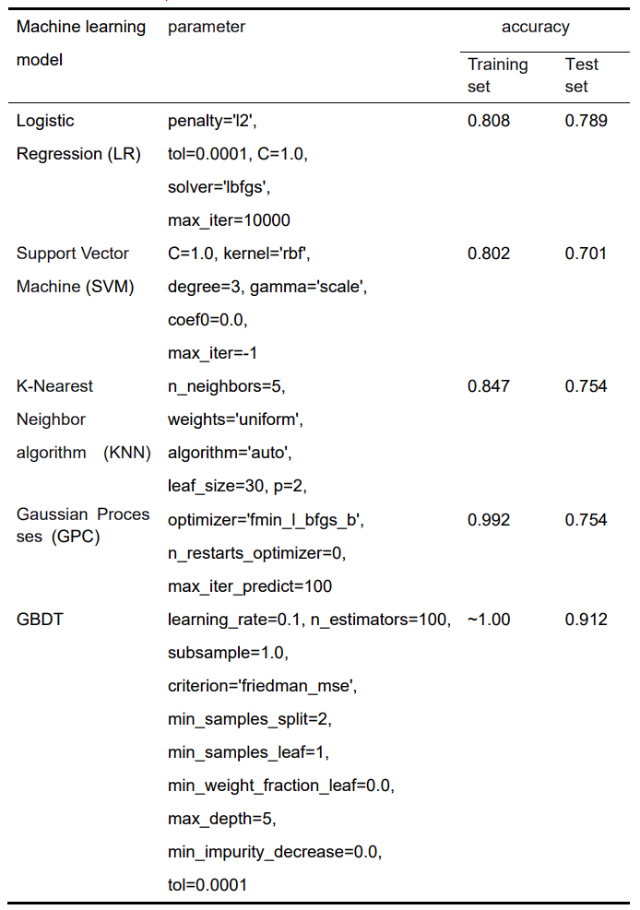

Slide 20
Conclusion
Machine learning-designed membranes:
High Zn²⁺ conductivity (up to 12 mS cm⁻¹) for efficient ion transport.
Low H⁺ conductivity minimizing crossover and energy loss.
Excellent mechanical stability for long-term durability.
Enhanced Zn/MnO2 flow battery performance:
Increased peak power density (150 mWcm⁻²) for faster charging/discharging.
Higher specific capacity (1.95 mAhcm⁻²) for more stored energy.
Stable cycling capacity retention (>71% after 1000 cycles).
Significance:
Machine learning effectively optimizes sulfonated polymer membranes for Zn/MnO2 flow batteries.
Opens the door for further advancement of high-performance batteries for sustainable energy storage

Slide 21
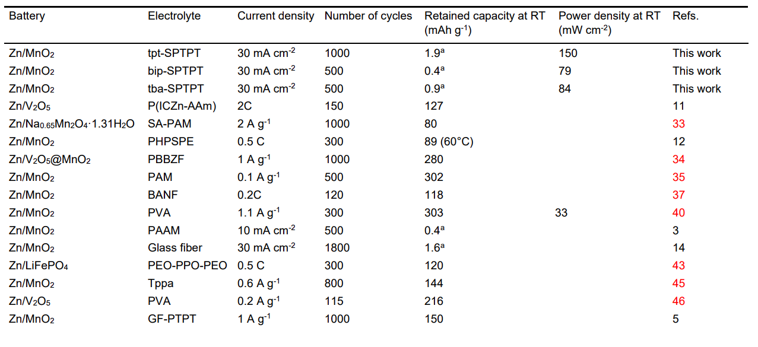
Comparison on the performance of ZIBs with various polymer electrolytes

